Slide 1

Weathering Event Planning
Kayla Ketner
Notes:
Motivation
Outdoor events are very popular across Nashville, TN. From personal family reunions and weddings to corporate sponsored retreats, concerts, or city-wide events like music festivals or marathons, the success and execution of these outdoor events depends greatly upon the weather. Poor weather can lead to decreased attendance, unexpected costs for moving or postponing, or even cancellation of the event. As an event planner, I have personal experience with challenges caused by weather, and predicting when poor weather is least likely to occur will help ensure events are planned accordingly, minimizing the risk of weather-related issues on the execution of the event.

Slide 2


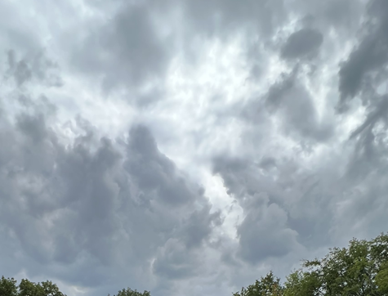
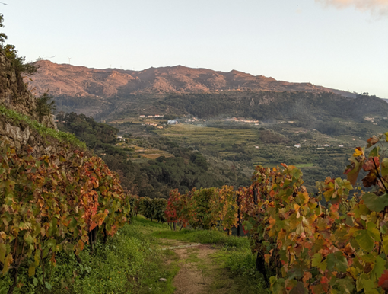
Overview
Weather & Events
Winter: December, January, February
Spring: March, April, May
Summer: June, July, August
Fall: September, October, November
Notes:
Using historical weather data and weather prediction models from the National Oceanic and Atmospheric Administration (NOAA), I will identify seasonal windows of 7 days where the weather has historically been ‘ideal’ for an outdoor event. Ideal weather changes per season, for instance, sunny and not raining is perfect for summer but extreme heat and humidity can make it miserable. Identifying the ideal weather per season, narrowing it to a specific window, and then using it to predict those dates for the upcoming year will be the scope of this project

Slide 3



Introduction
‘What’s the weather like?” is a question many of us ask every day; it influences what we wear, what we do, and even our mood. Think about how bad weather can turn a great day bad with a single clap of thunder, or that magical feeling of seeing a hint of sunshine after a week of rain. The weather influences our day-to-day life, so of course that influence is magnified for outdoor events, such as festivals or weddings.
Data Question: Based upon the past 50 years of weather data, what day(s) have the most consistent weather to plan an outdoor event in Nashville, TN? With this data, a date range (7 days) will be chosen per season for 2025 to plan an outdoor event.
For each season, weather variable averages, variable scoring, and optimal days will be explored.

Slide 4
Process
Data Gathering
Daily Climate Data from July 1, 1974 - June 30, 2024.
Cleaning
Steps:
Scoring
Each day was assigned 3 scores based upon weather variables.
Dates
Optimal Dates per season chosen by user preference score.
Looking Ahead
This data and scoring can be used to inform future weather patterns and plan accordingly.
Weather Station at Nashville International Airport.
Convert Units
Split into Seasons
Normalize
Narrow Data
Score out of 10
8 and above = Ideal
5.5-8 = Good, but not Great
5.5 and below = Not Ideal

Slide 5
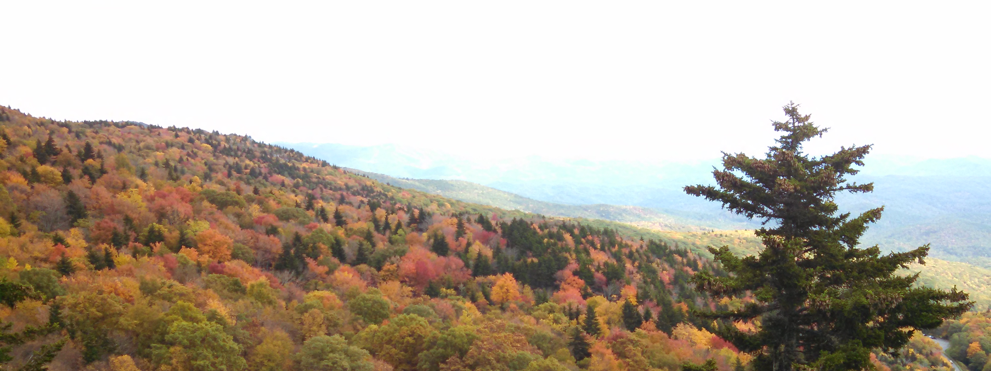
Weather Variables
Precipitation
Snow
Maximum Temperature
Minimum Temperature
Average Daily Wind Speed
Average Relative Humidity
Average Daily Temperature

Slide 6

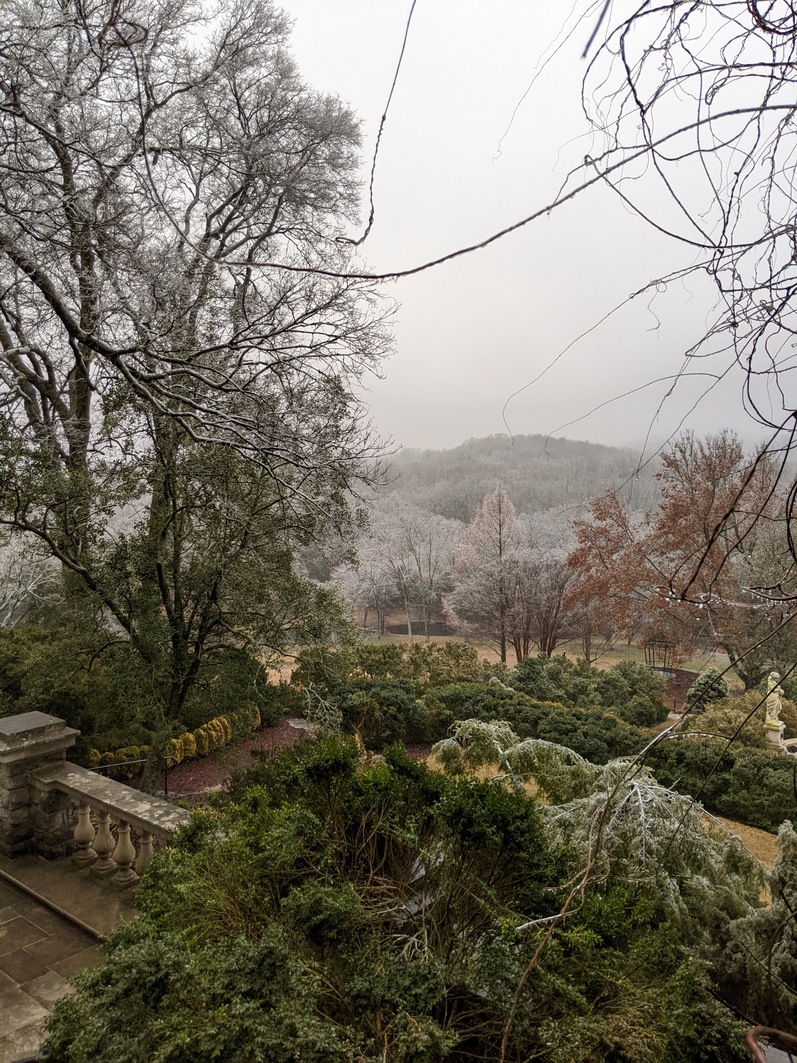
Winter Averages
Precipitation
0.14 inches
Snow
Maximum Temperature
Minimum Temperature
Average Daily Wind Speed
Average Daily Temperature
0.066 inches
50.34℉
31.29℉
8.02 mph
42.52℉

Slide 7
Winter Scoring
 | Score 1 | Score 2 | Score 3
Weight | All Equal | Precipitation & Temperature | Precipitation & Temperature
Precipitation | Lower 50% of Distribution | Lower 50% of Distribution | Lower 75% of Distribution
Snow | Lower 50% of Distribution | Lower 50% of Distribution | Lower 75% of Distribution
Maximum Temperature | Upper 50% | Upper 50% | Upper 75%
Minimum Temperature | Upper 50% | Upper 50% | Upper 75%
Average Daily Wind Speed | Lower 25% | Lower 25% | Lower 25%
Average Daily Temperature | Upper 50% | Upper 50% | Upper 50%

Slide 9
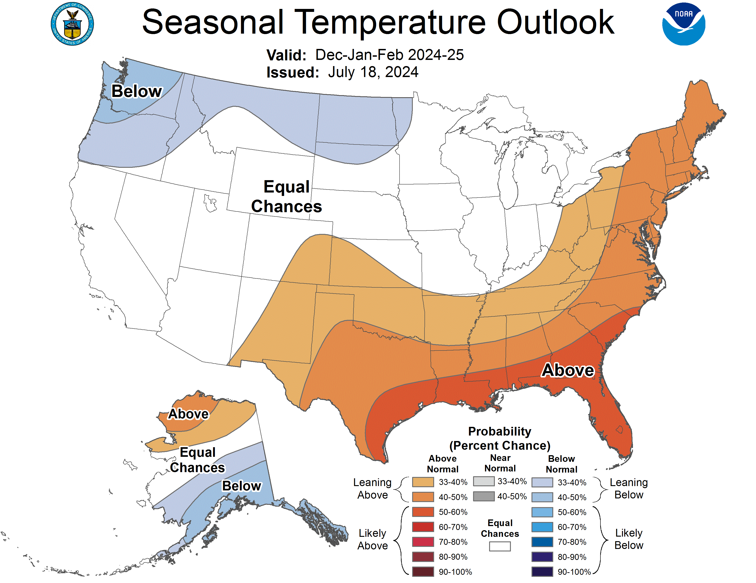
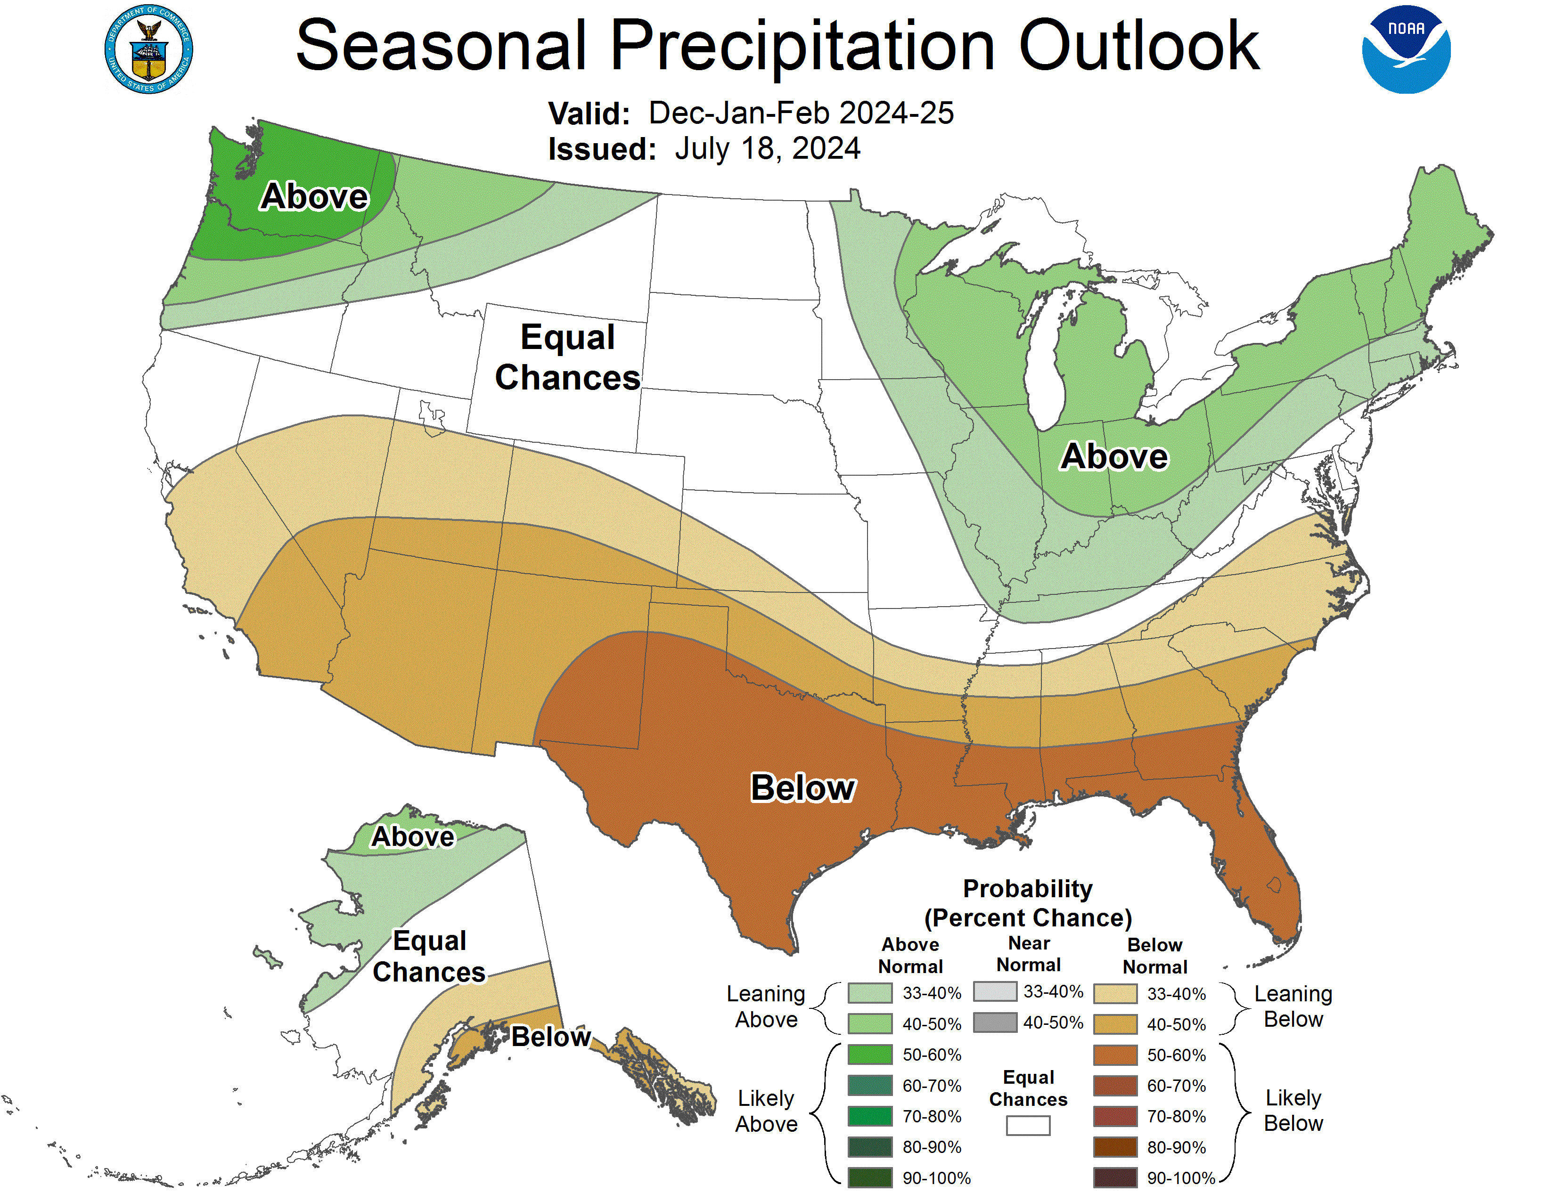
Winter 2024/2025
Optimal Days
Score 1: 5.95, February 19th-25th
Score 2: 6.69, February 19th-25th
Score 3: 7.82, December
Source: NOAA NWS Climate Prediction Center https://www.cpc.ncep.noaa.gov/products/predictions/long_range/seasonal.php?lead=5

Slide 10

Spring Averages
Precipitation
0.154 inches
Maximum Temperature
Minimum Temperature
Average Daily Wind Speed
Average Daily Temperature
70.94℉
48.79℉
7.78 mph
60.97℉

Slide 11
Spring Scoring
 | Score 1 | Score 2 | Score 3
Weight | All Equal | Precipitation & Temperature | Precipitation & Temperature
Precipitation | Lower 50% of Distribution | Lower 50% of Distribution | Lower 75% of Distribution
Maximum Temperature | Between 50% & 75% | Between 50% & 75% | Between 25% & 75%
Minimum Temperature | Upper 50% | Upper 50% | Upper 75%
Average Daily Wind Speed | Lower 25% | Lower 25% | Lower 25%
Average Daily Temperature | Upper 50% | Upper 50% | Upper 50%

Slide 12


Slide 13
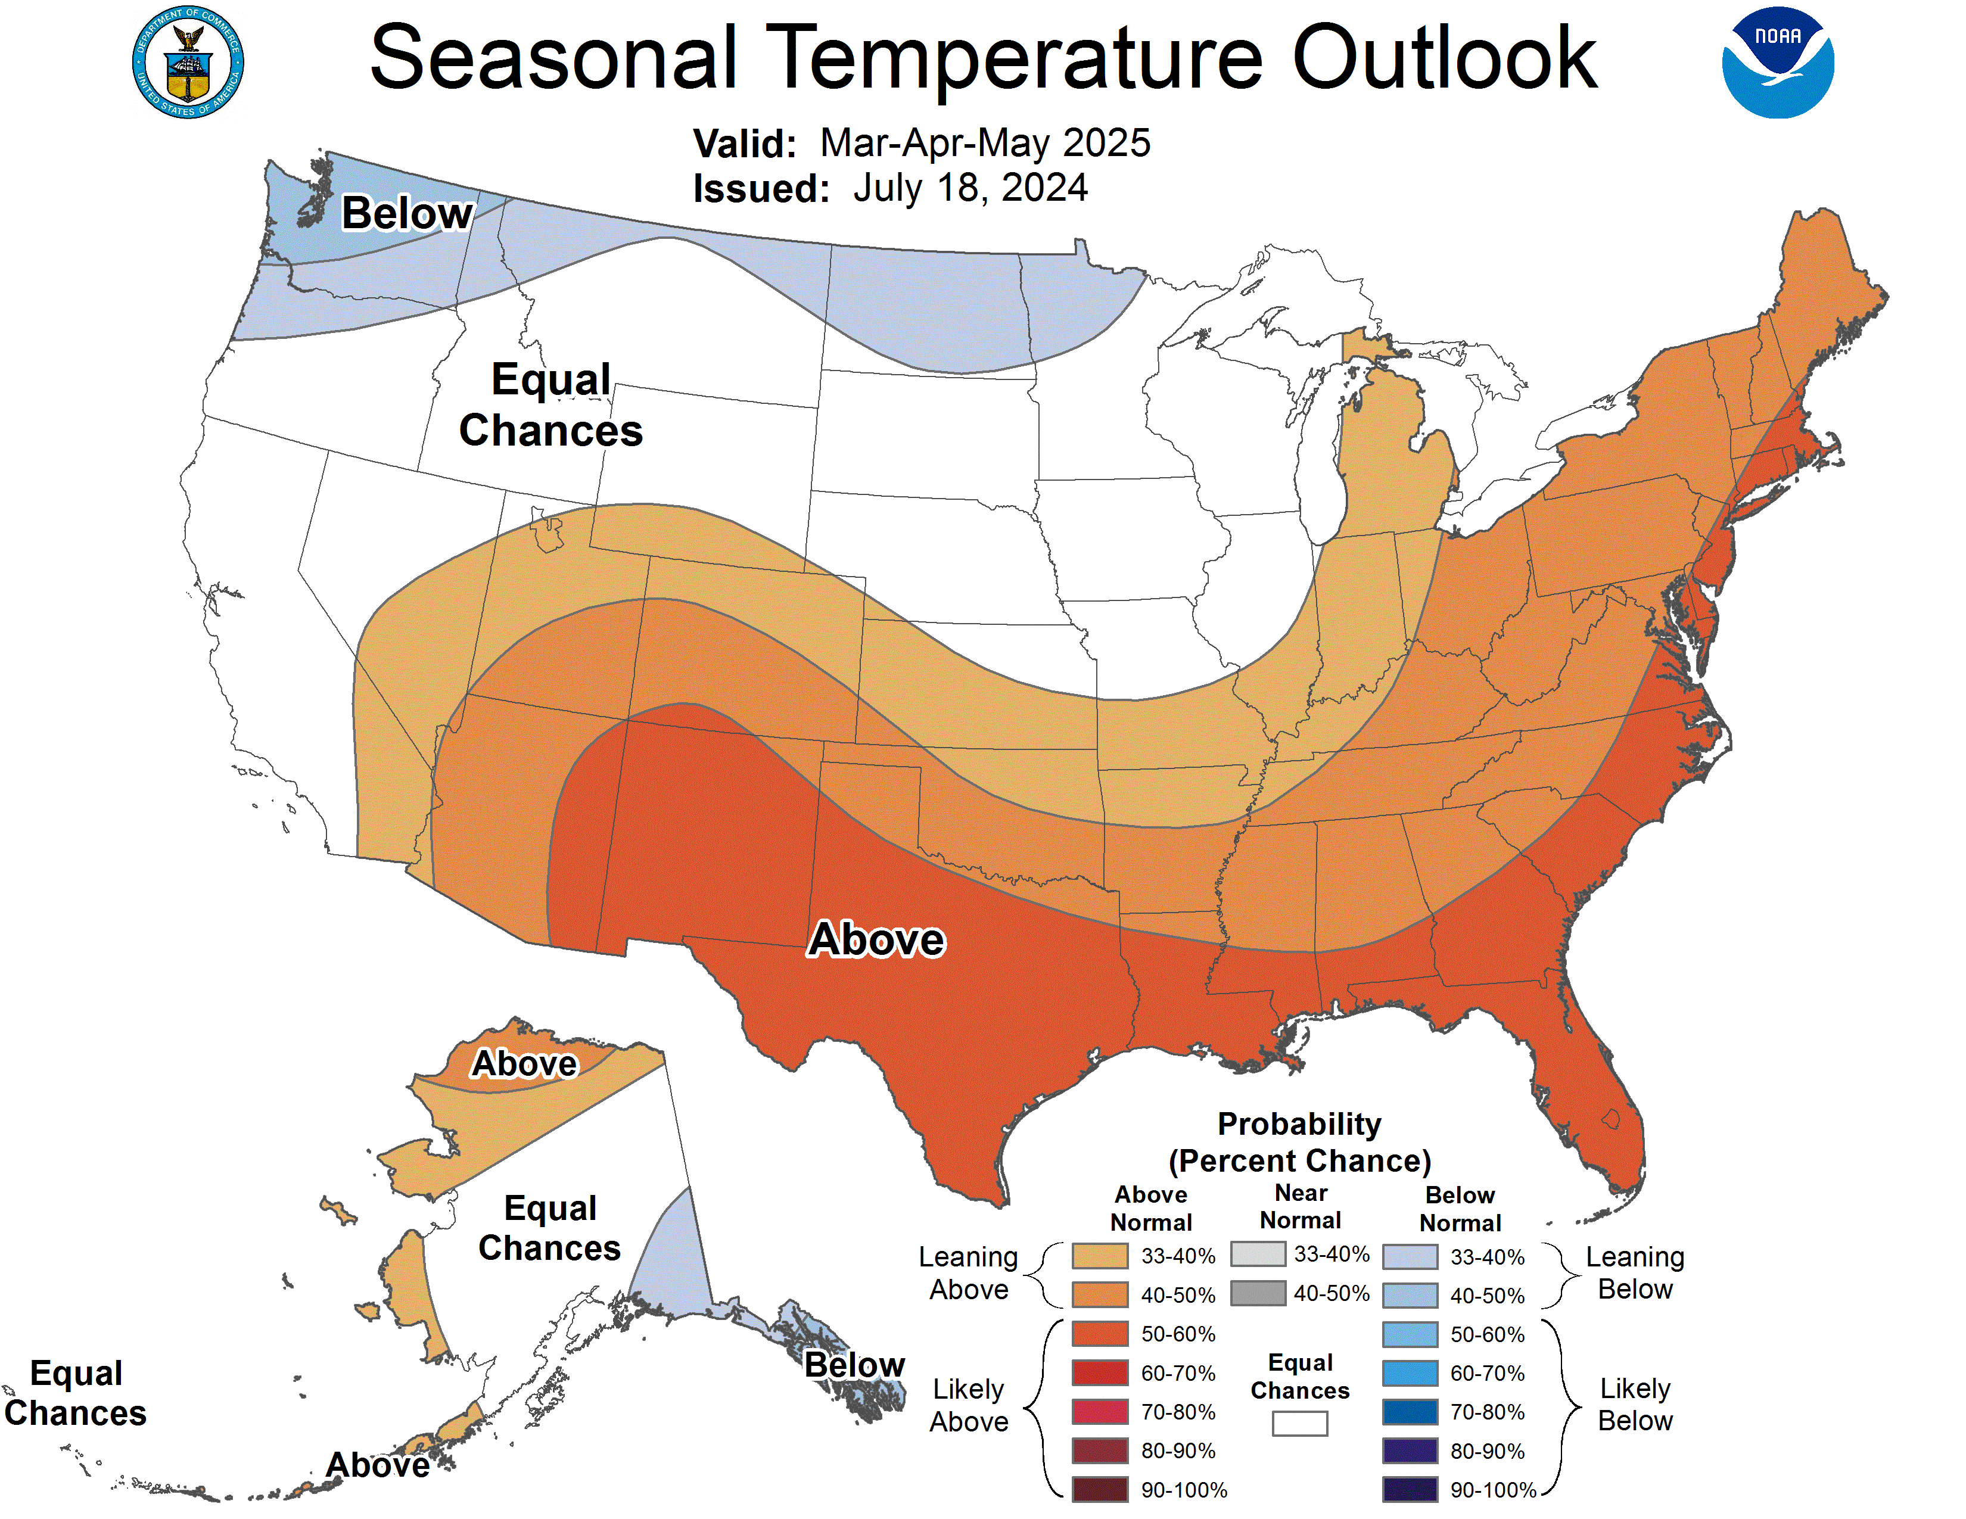
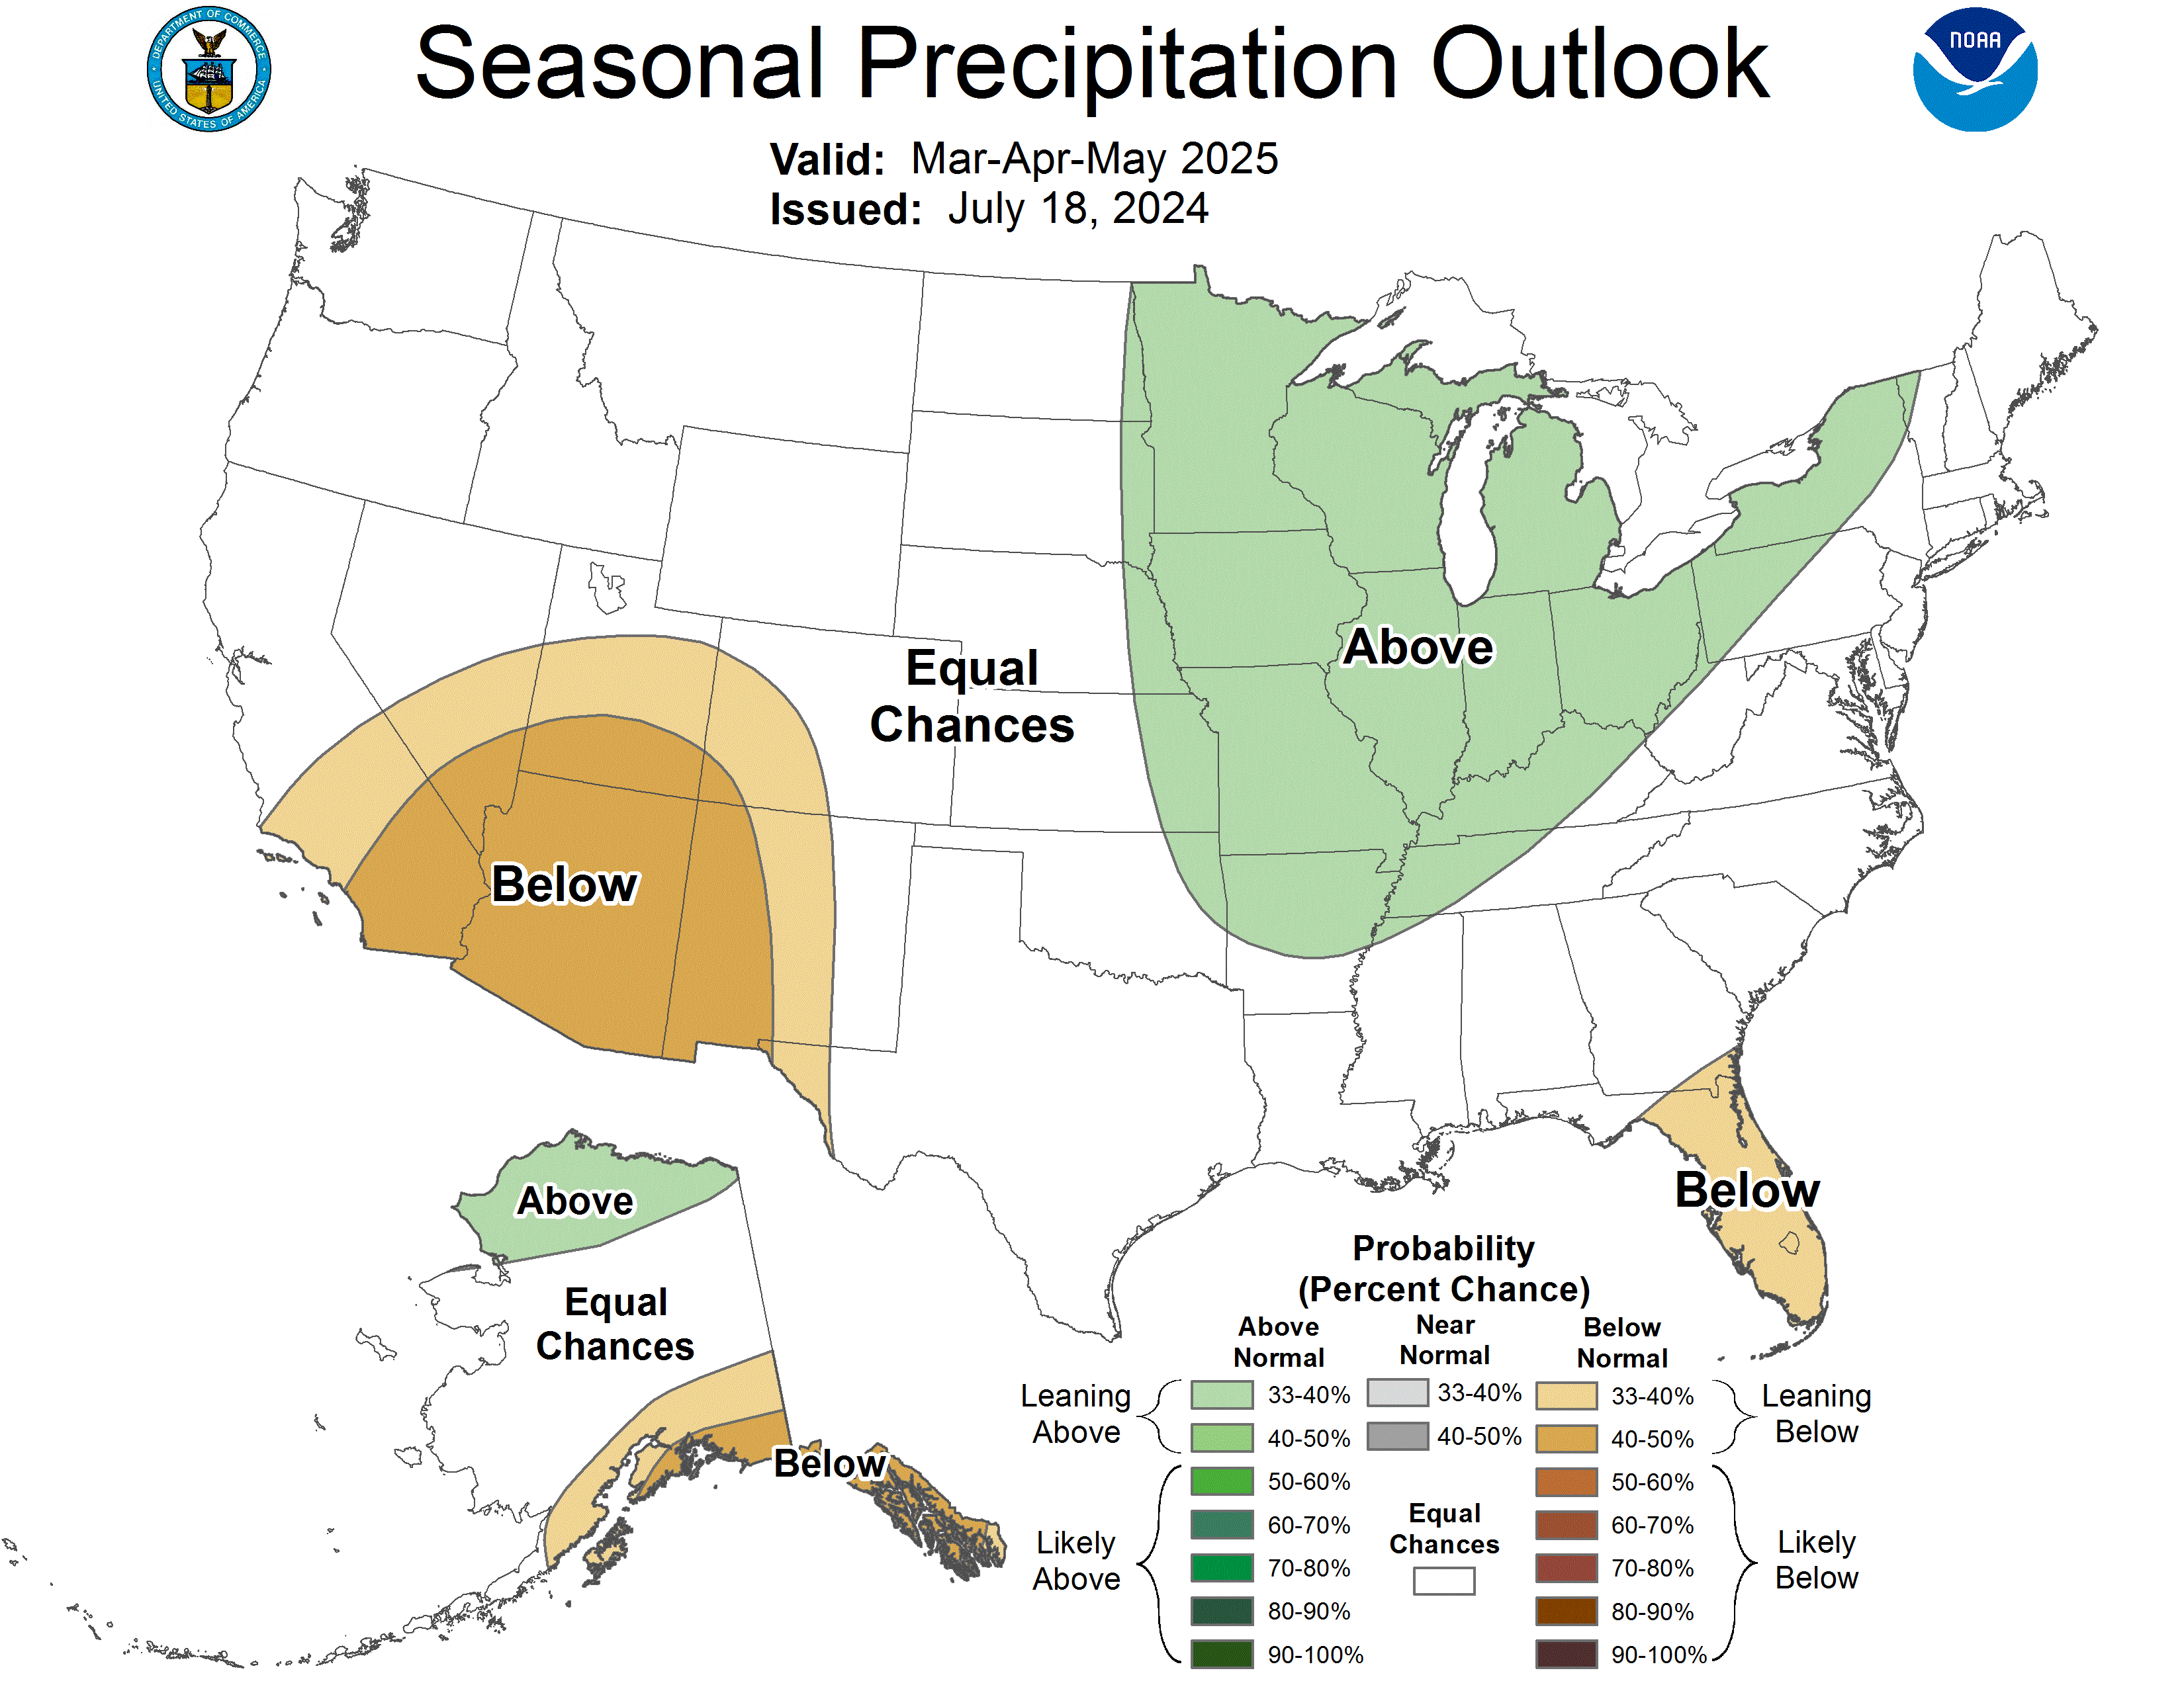
Spring 2025
Optimal Days
Score 1: Days
Score 2: Days
Score 3: Days
Source: NOAA NWS Climate Prediction Center https://www.cpc.ncep.noaa.gov/products/predictions/long_range/seasonal.php?lead=8

Slide 14


Summer Averages
Precipitation: 0.127 inches
Maximum Temperature: 88.84℉
Minimum Temperature: 68.48℉
Average Daily Wind Speed: 5.79 mph
Average Daily Temperature: 78.63℉
Average Relative Humidity: 66.15%

Slide 15
Summer Scoring
 | Score 1 | Score 2 | Score 3
Weight | All Equal | Precipitation & Temperature | Precipitation & Temperature
Precipitation | Lower 50% of Distribution | Lower 50% of Distribution | Lower 75% of Distribution
Maximum Temperature | Lower 50% | Lower 50% | Lower 75%
Minimum Temperature | Upper 50% | Upper 50% | Upper 75%
Average Daily Wind Speed | Lower 50% | Lower 50% | Lower 50%
Average Relative Humidity | Lower 50% | Lower 50% | Lower 50%
Average Daily Temperature | Upper 50% | Upper 50% | Upper 50%

Slide 16
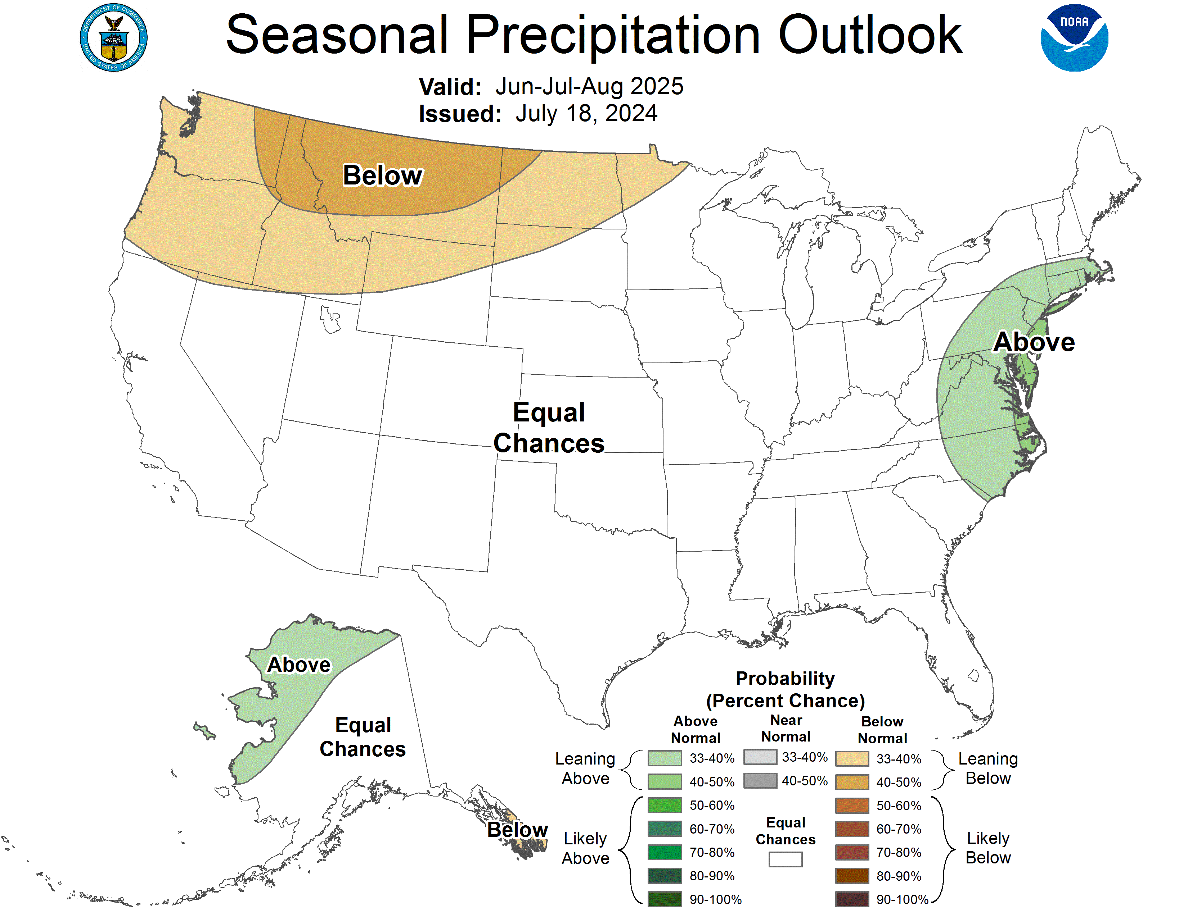
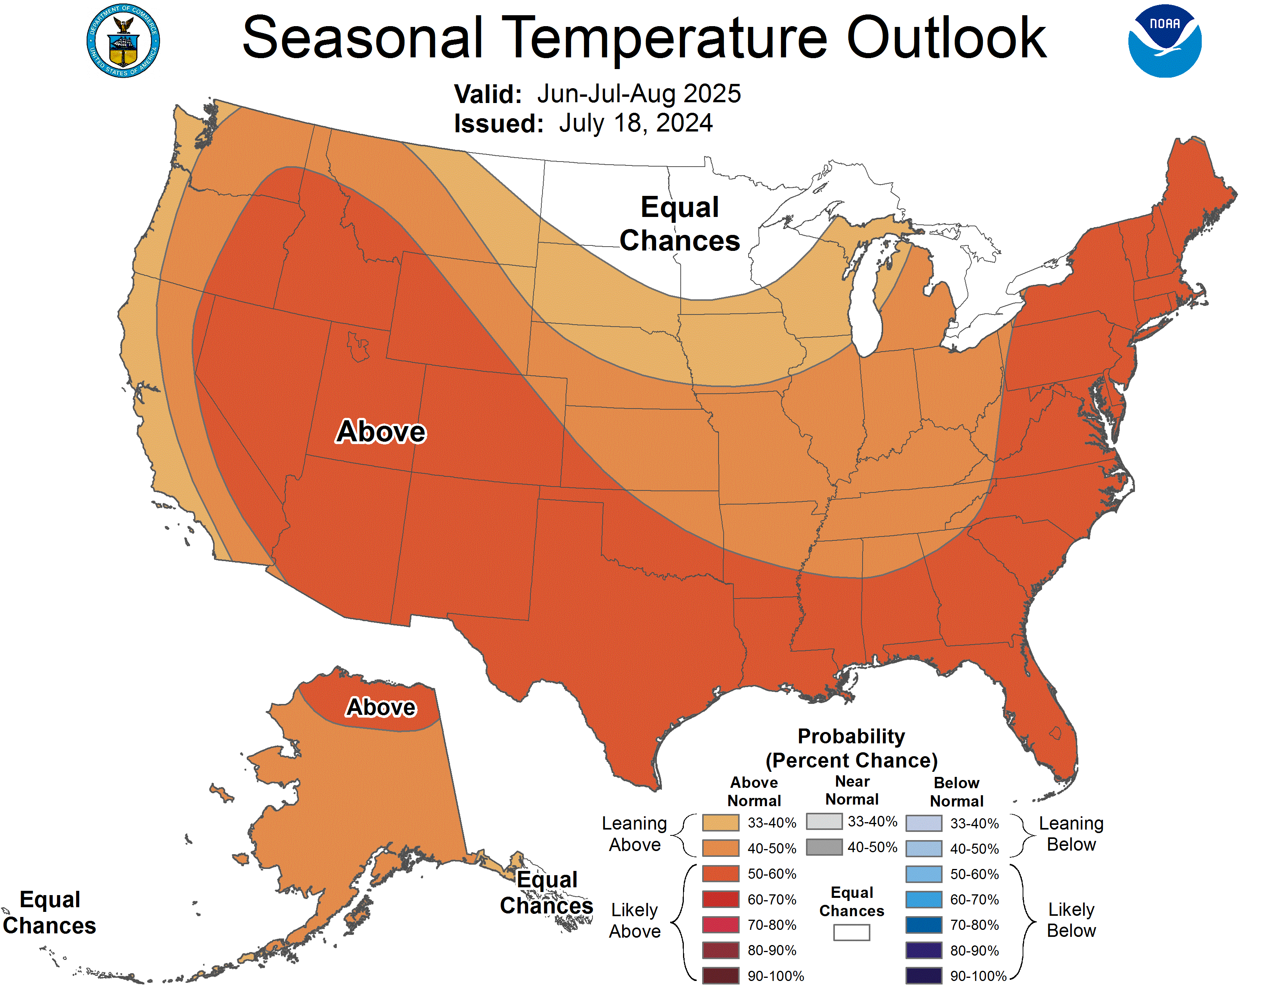
Summer 2025
Optimal Days
Score 1: Days
Score 2: Days
Score 3: Days
Source: NOAA NWS Climate Prediction Center https://www.cpc.ncep.noaa.gov/products/predictions/long_range/seasonal.php?lead=11

Slide 18


Fall Averages
Precipitation
Maximum Temperature
Minimum Temperature
Average Daily Wind Speed
Average Daily Temperature
Average Relative Humidity
0.12 inches
72.02℉
50.2℉
6.4 mph
65.04%
62.3℉

Slide 19
Fall Scoring
 | Score 1 | Score 2 | Score 3
Weight | All Equal | Precipitation & Temperature | Precipitation & Temperature
Precipitation | Lower 50% of Distribution | Lower 50% of Distribution | Lower 75% of Distribution
Maximum Temperature | Between 50% & 75% | Between 50% & 75% | Between 25% & 75%
Minimum Temperature | Upper 50% | Upper 50% | Upper 75%
Average Daily Wind Speed | Lower 50% | Lower 50% | Lower 50%
Average Relative Humidity | Lower 50% | Lower 50% | Lower 50%
Average Daily Temperature | Upper 50% | Upper 50% | Upper 50%

Slide 21
Fall 2025
Optimal Days
Score 1: Days
Score 2: Days
Score 3: Days

Slide 22

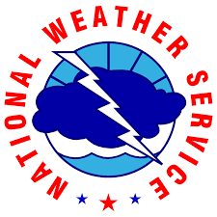
Sources
Menne, Matthew J., Imke Durre, Bryant Korzeniewski, Shelley McNeill, Kristy Thomas, Xungang Yin, Steven Anthony, Ron Ray, Russell S. Vose, Byron E.Gleason, and Tamara G. Houston (2012): Global Historical Climatology Network - Daily (GHCN-Daily), Version 3. NOAA National Climatic Data Center. doi:10.7289/V5D21VHZ [31 July 2024].
NOAA NWS Climate Prediction Center

Slide 23
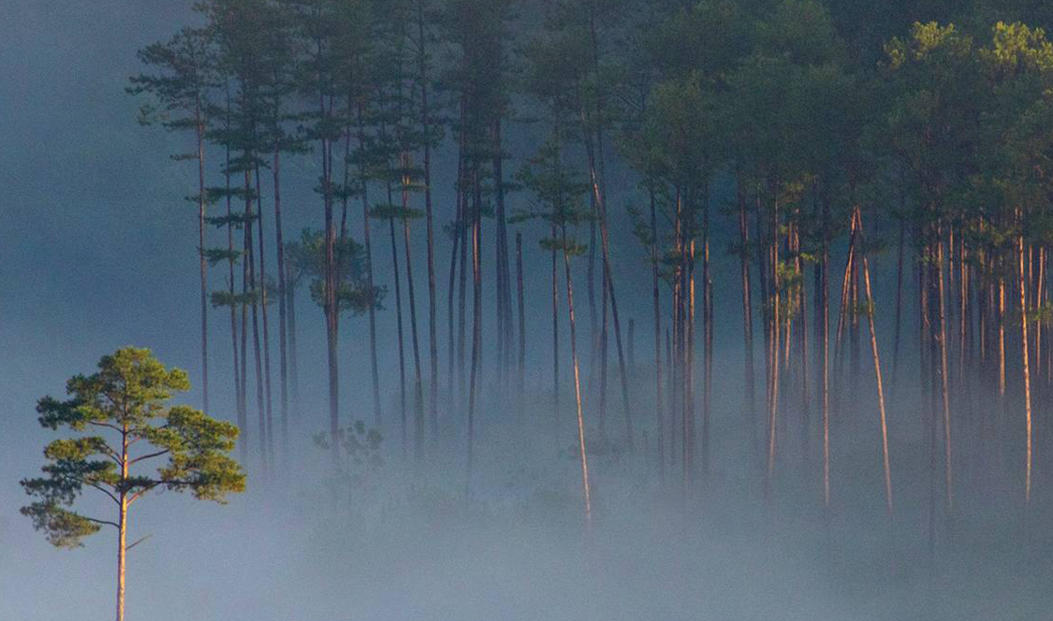
Thank you!
Kayla Ketner
Email
LinkedIn
GitHub

Slide 24
Chart

